Slide 1
Proposed Forced
Labour Regulation
Aleksandra Kozlowska
Head of Trade Section
European Economic and Trade Office

Slide 2
WHAT IS FORCED LABOUR?
THE PROPOSAL
WHAT IS THE EU DOING?

Slide 3
WHAT IS FORCED LABOUR?

Slide 4
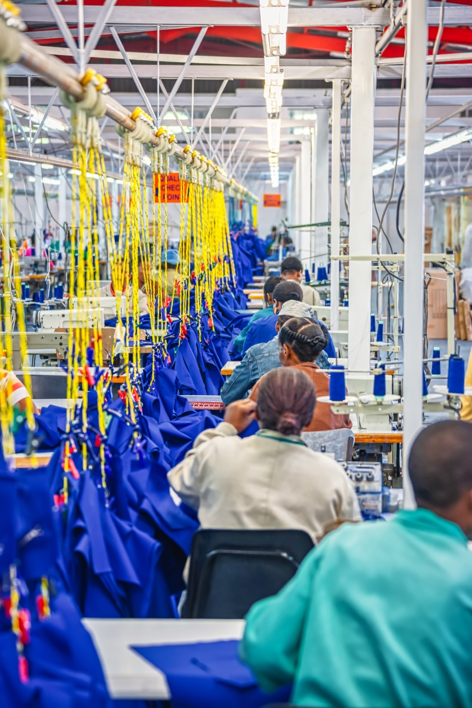
ILO definition:
All work or service which is exacted from any person under the menace of any penalty and for which the said person has not offered himself voluntarily.
ILO indicators:
Abuse of vulnerability
Deception
Restriction of movement
Isolation
Physical and sexual violence
Intimidation and threats
Retention of identity documents
Withholding of wages
Debt bondage
Abusive working and living conditions
Excessive overtime

Slide 5
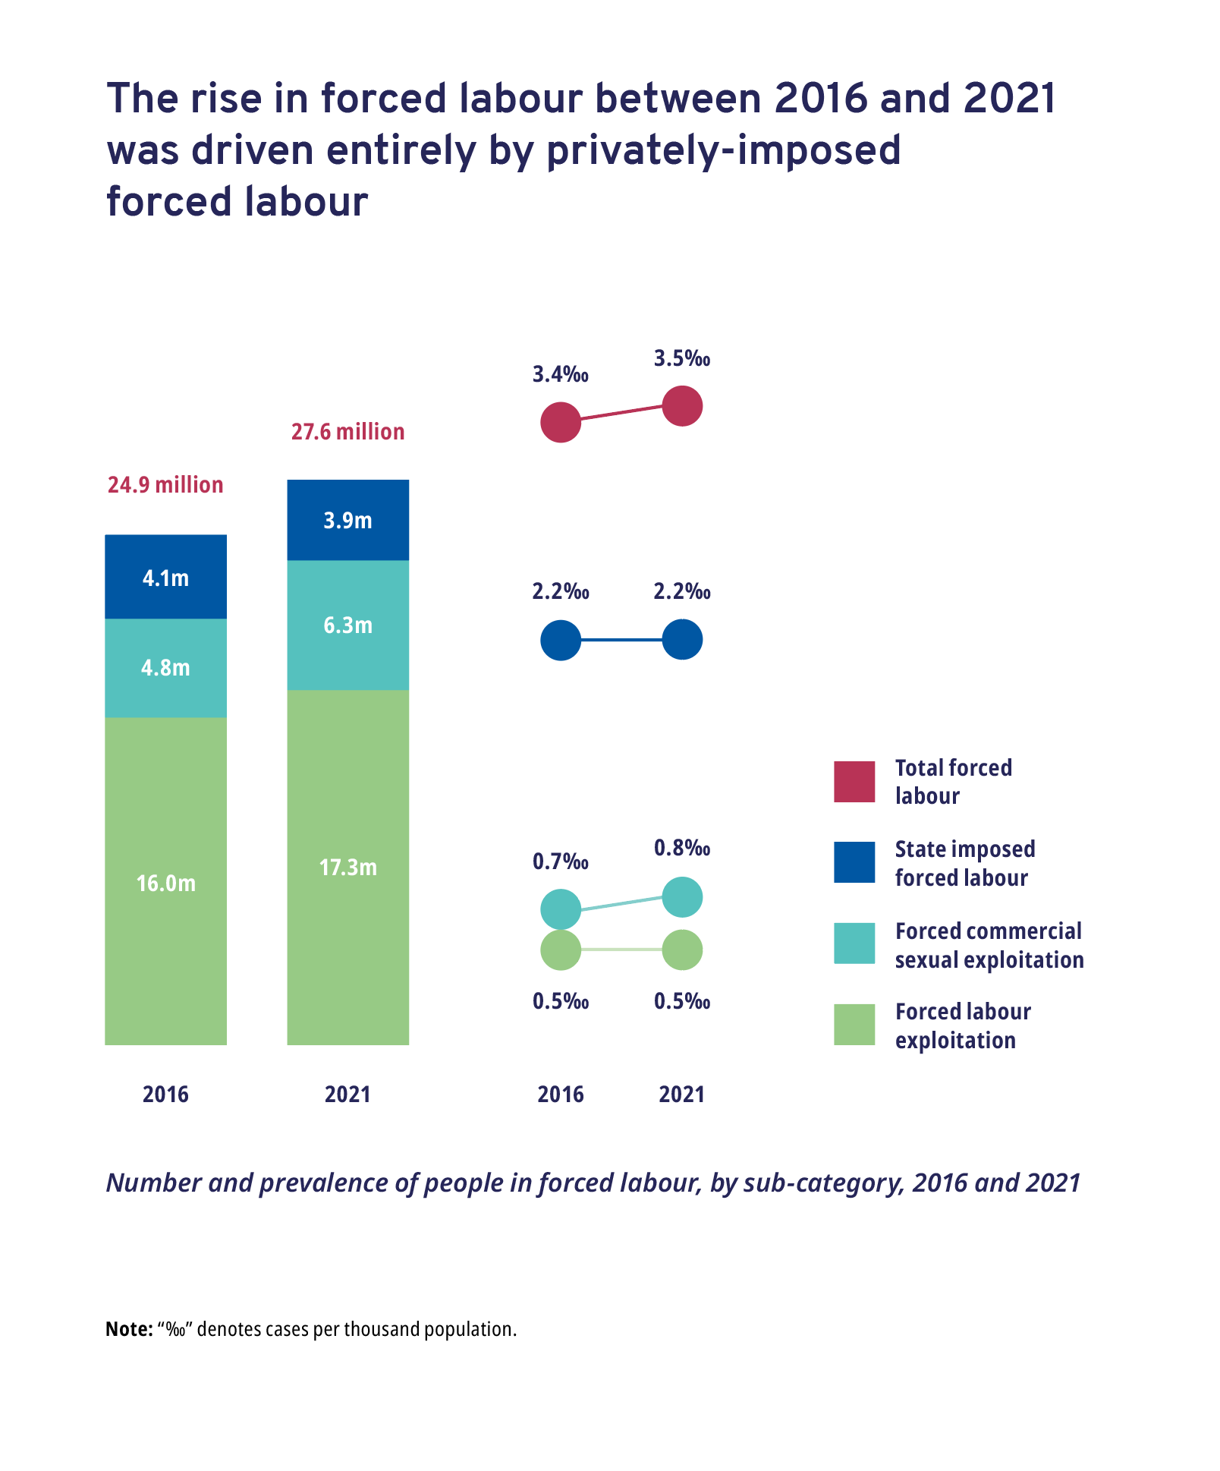
ILO Global Estimates report released on
12 September 2022
27.6 million people in forced labour
86% imposed by private actors
Increase in recent years (24.9 million in 2016)
Source: 2021 Global Estimates of Modern Slavery: Forced Labour and Forced Marriage

Slide 6
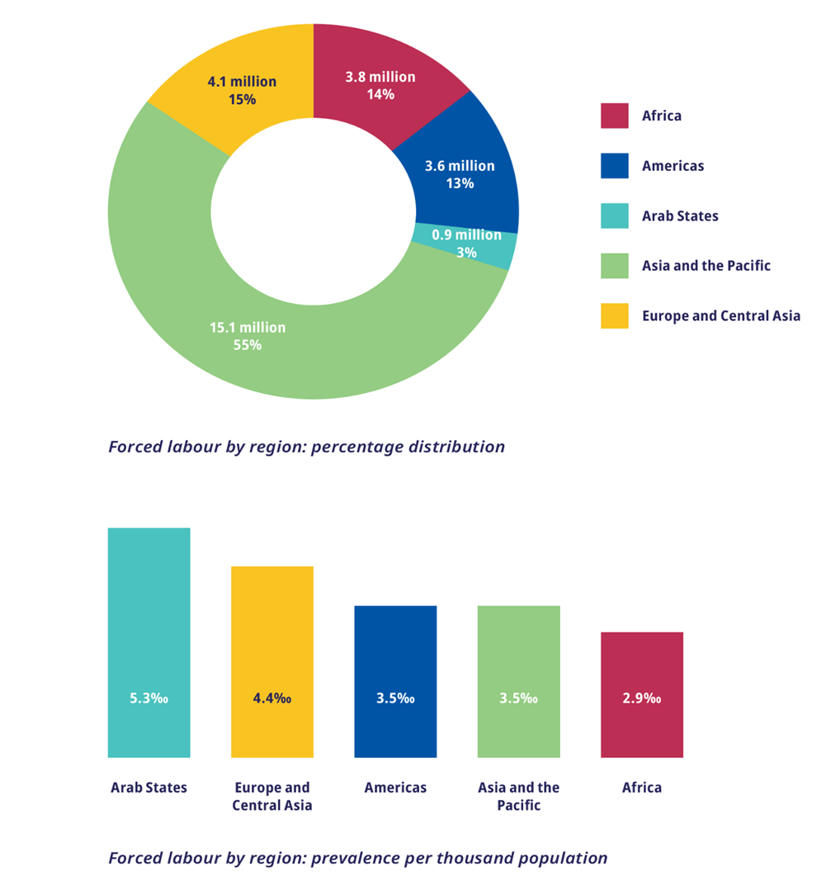
Forced labour in the world: regions
Asia and the Pacific region has the highest number of people (55% of total forced labour)
Arab States have the highest prevalence of forced labour (5.3 per thousand)
880,000 forced labour victims in the EU (in addition to forced labour involved in, for instance, the EU’s imports from the rest of the world)
Source: 2021 Global Estimates of Modern Slavery: Forced Labour and Forced Marriage

Slide 7
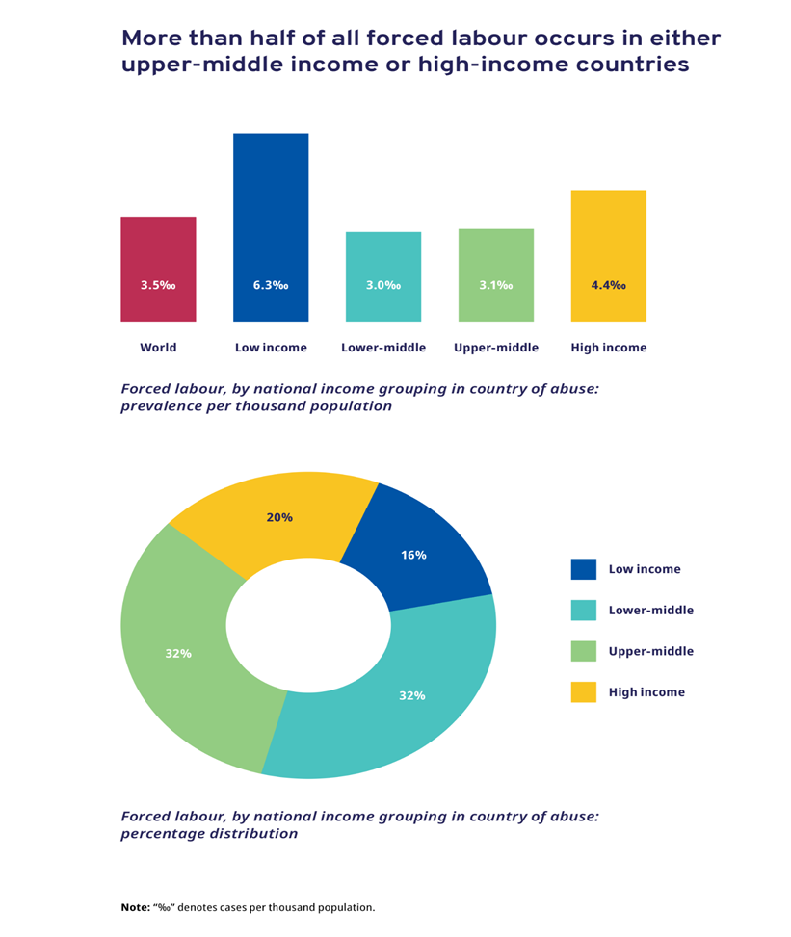
Forced labour in the world: income distribution
“Forced labour is a concern in countries of all income levels, including the richest”
Prevalence is not directly correlated with income levels
Source: 2021 Global Estimates of Modern Slavery: Forced Labour and Forced Marriage

Slide 8
WHAT IS THE EU DOING?

Slide 9

EU context: legislative and other measures
Instuments in force
  Conflict Minerals Regulation
  EU Anti-Trafficking Directive
  Corporate Sustainability Reporting Directive
  Forced Labour Due Diligence Guidance
Instruments in preparation
  Corporate Sustainability Due Diligence Directive
  Sustainable Batteries Regulation
  Deforestation Regulation

Slide 10
Specific legislation and other policies in EU Member States
All EU Member States have ratified the ILO Forced Labour Convention (No 29) and the Abolition of Forced Labour Convention (No 105)
19 EU Member States have ratified the 2014 Protocol to the Forced Labour Convention
Member States’ national initiatives on Business and Human Rights and Responsible Business Conduct
  National Action Plans
  Due diligence legislation

Slide 11

International context: cooperation with partners
  Trade instruments (TSD, GSP)
  Bilateral fora (e.g. human rights dialogues), engagement with like-minded countries (US, Canada, Switzerland etc.)
  Multilateral fora (e.g. G7)
  International organisations (ILO, UN, OECD)
  Support measures / technical assistance

Slide 12
THE PROPOSAL

Slide 13


Proposed instrument: a marketing ban products made with forced labour
  EU-manufactured products (for domestic consumption and exports) and imported products
  Built on international standards and on international cooperation
  Risk-based enforcement by Member States' competent authorities (in cooperation with other national authorities, notably customs)
  Coordination role by European Commission

Slide 14
Mechanism
evidence
(In cases of non-cooperation: based on facts available)
If substantiated concerns
review possible
1
2
3
4
5
Submissions/
Indicators/
Database/
Information
Preliminary
phase
Investigation
Marketing prohibition and withdrawal from EU market
Enforcement in the EU and at the border

Slide 15


Commission’s role: coordination and tools for implementation
Public database of forced labour risks areas or products (by external expert)
Cooperation between competent authorities
  EU Forced Labour Product Network
  Information and communication system
Guidance for companies and competent authorities

Slide 16
Thank you
Notes:
Update/add/delete parts of the copy right notice where appropriate.
More information: https://myintracomm.ec.europa.eu/corp/intellectual-property/Documents/2019_Reuse-guidelines%28CC-BY%29.pdf

